Slide 1
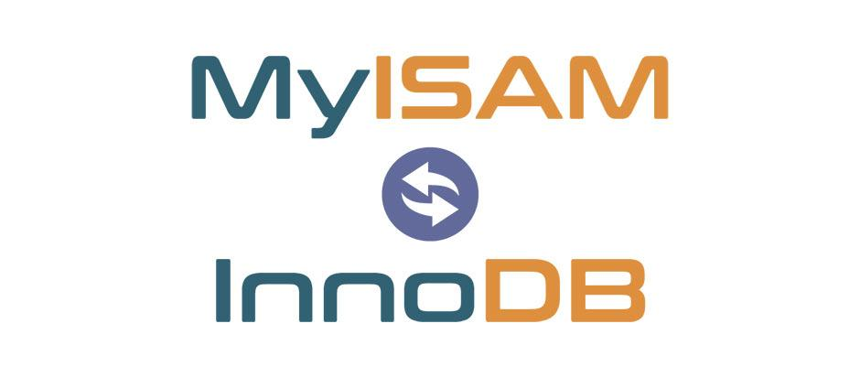


Database Engines
husseinnasser.com
History and comparisons

Slide 2
Agenda
What is a Database Engine?
MyISAM
Aria
InnoDB
XtraDB
LevelDB
RocksDB
SQLite
Berkeley DB
Demo (Switching Engines with MySQL)

Slide 3
Database Engine
Library that takes care of the on disk storage and CRUD
Can be as simple as key-value store
Or as rich and complex as full support ACID and transactions with foreign keys
DBMS can use the database engine and build features on top (server, replication, isolation, stored procedures, etc..)
Want to write a new database? Don’t start from scratch use an engine.
Sometimes referred as Storage Engine or embedded database

Slide 4
Database Engines
Some DBMS gives you the flexibility to switch engines like MySQL & MariaDB
Some DBMS comes with a built-in engine that you can’t change (Postgres)

Slide 5
MyISAM
Stands for Indexed sequential access method
B-tree (Balanced tree) indexes point to the rows directly
No Transaction support
Open Source & Owned by Oracle
Inserts are fast, updates and deletes are problematic (fragments)
Database Crashes corrupts tables (have to manually repair)
Table level locking
MySQL, MariaDB, Percona (MySQL forks) supports MyISAM
Used to be default engine for MySQL

Slide 6
Aria
Created by Michael Widenius
Very similar to MyISAM
Crash-safe unlike MyISAM
Not owned by Oracle
Designed specifically for MariaDB (mySQL Fork)
In MariaDB 10.4 all system tables are Aria

Slide 7
InnoDB
B+tree - with indexes point to the primary key and the PK points to the row
Replaces MyISAM
Default for MySQL & MariaDB
ACID compliant transactions support
Foreign keys
Tablespaces
Row level locking
Spatial operations
Owned by Oracle

Slide 8
XtraDB
Fork of InnoDB
Was the default for MariaDB until 10.1
In MariaDB 10.2 switched the default for InnoDB
“XtraDB couldn’t be kept up to date with the latest features of InnoDB and cannot be used.” (link)
System tables in MariaDB starting with 10.4 are all Aria

Slide 9
LevelDB
Written by Jeff and Sanjay from Google in 2011
Log structured merge tree (LSM) (great for high insert and SSD)
No transactions
Inspired by Google BigTable
Levels of files
Memtable
Level 0 (young level)
Level 1 - 6
As files grow large levels are merged
Used in bitcoin core blockchain, AutoCad, Minecraft

Slide 10
RocksDB
Facebook forked LevelDB in 2012 to become RocksDB
Transactional
High Performance, Multi-threaded compaction
Many features not in LevelDB
MyRocks for MySQL, MariaDB and Percona
MongoRocks for MongoDB
Many many more use it!

Slide 11
SQLite
Designed by D. Richard Hipp in 2000
Very populate embedded database for local data
B-Tree (LSM as extension)
Postgres-like syntax
Full ACID & table locking
Concurrent read & writes
Web SQL in browsers uses it
Included in many operating systems by default

Slide 12
Berkeley DB
Developed by Sleepycat Software in 1994 (owned by Oracle)
Key-value embedded database
Supports ACID transactions, locks, replications etc..
Used to be used in bitcoin core (switched to LevelDB)
Used MemcacheDB

Slide 13
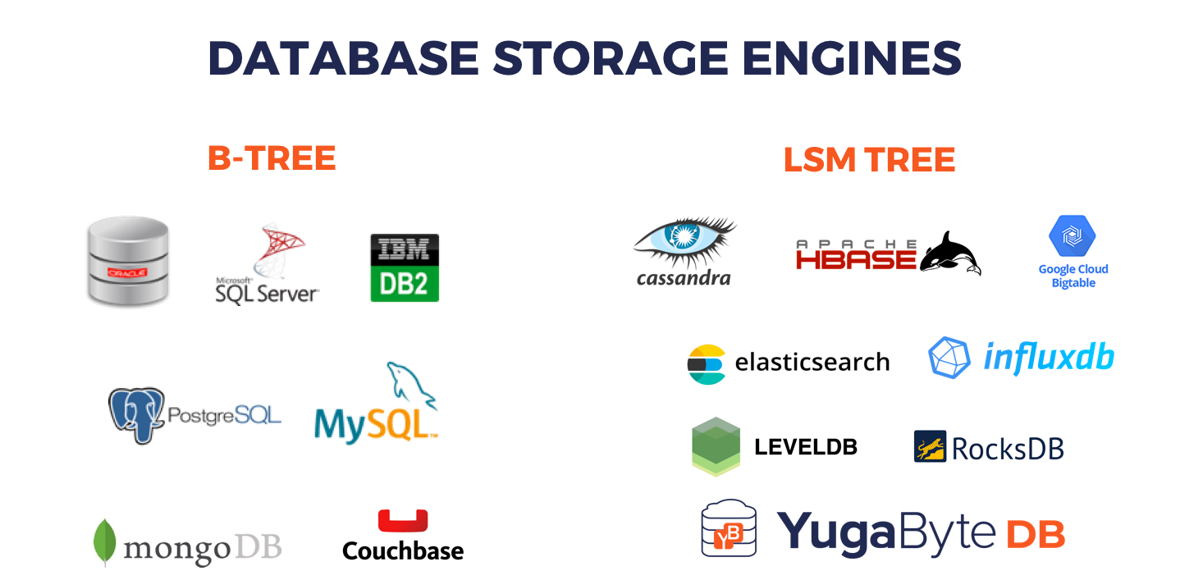
https://blog.yugabyte.com/a-busy-developers-guide-to-database-storage-engines-the-basics/

Slide 14
Demo mySQL
Spin up a mySQL docker container
Create a table myISAM
Create a table innoDB
Connect to the database with Javascript
See how transactions behave on myISAM vs innoDB

Slide 15
Summary
What is a Database Engine?
MyISAM
Aria
InnoDB
XtraDB
LevelDB
RocksDB
SQLite
Berkeley DB
Demo (Switching Engines with MySQL)

